Slide 1
AOOP final project
組員:0610741張祐誠 0610837陳達軒

Slide 2
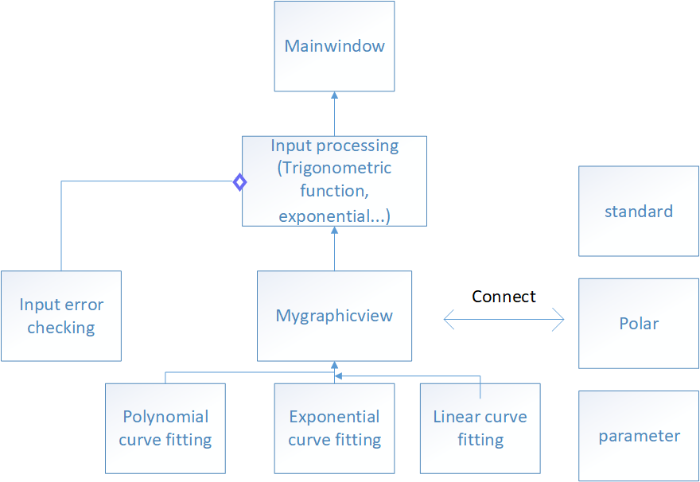
Flow Chart

Slide 3
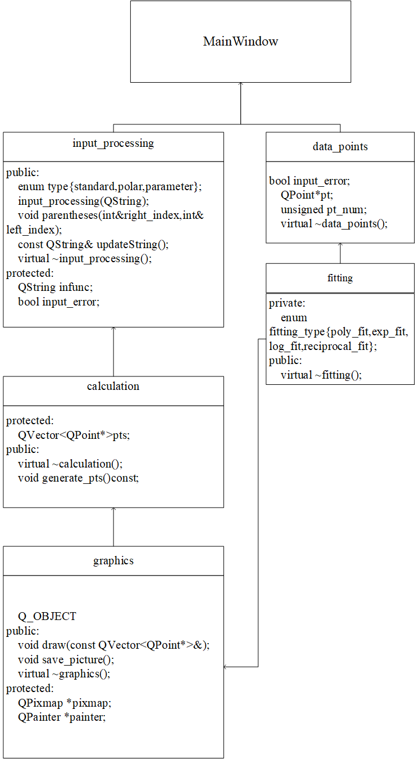
Class Hierarchy

Slide 4
Features
Input checking
Graphic plotting
Output images
Polynomial fitting
Exponential fitting
Linear fitting
Other math models
Standard
Polar
Parameter

Slide 5
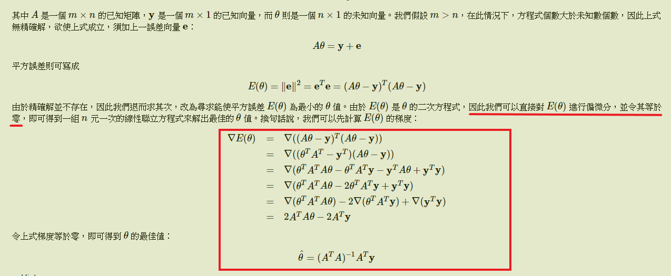
Outline
How to fit the data points?

Slide 6
IDE:QT creator
Reference:
http://mathworld.wolfram.com/LeastSquaresFittingExponential.html
http://mirlab.org/jang/books/matlabprogramming4guru/10-8_lseDerivation.asp?title=10-8%20%B3%CC%A4p%A5%AD%A4%E8%AAk%AA%BA%B1%C0%BE%C9
https://stackoverflow.com/questions/2430877/how-to-save-a-qpixmap-object-to-a-file

